Slide 1
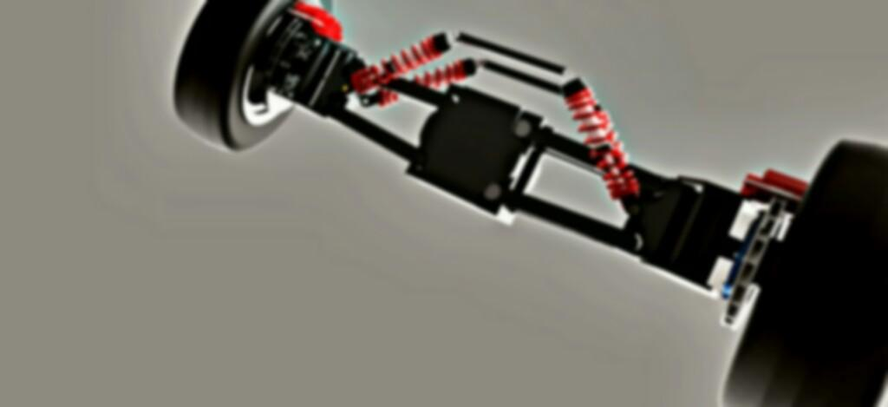
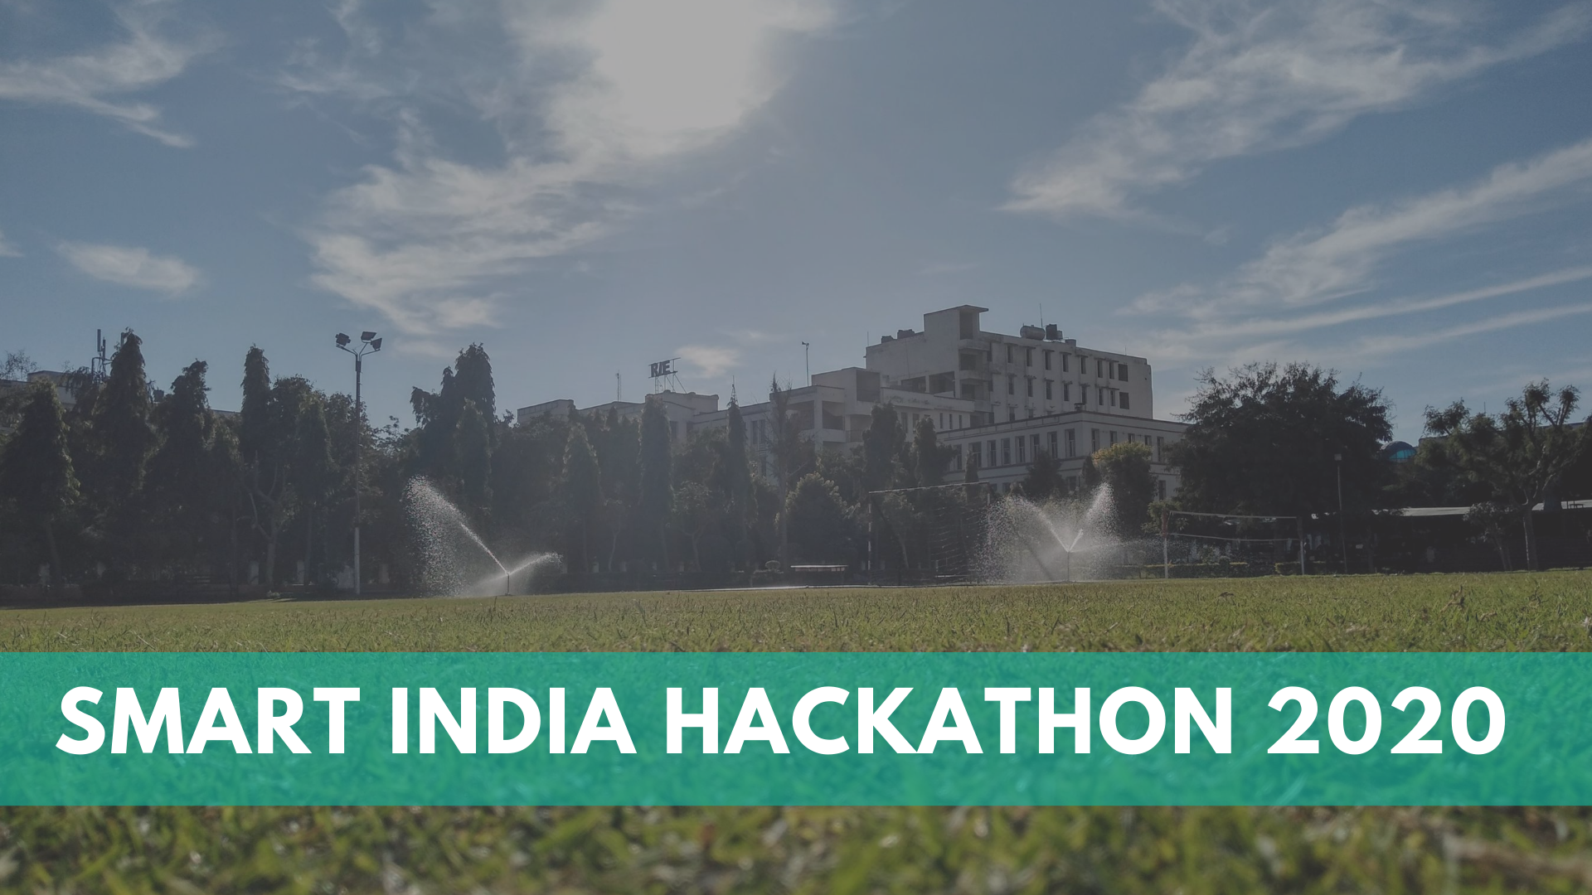
Smart India Hackathon 2020

Slide 2

Team name : Technothorn
Project name : Ultra-compact Personal Aerial Vehicle

Slide 3
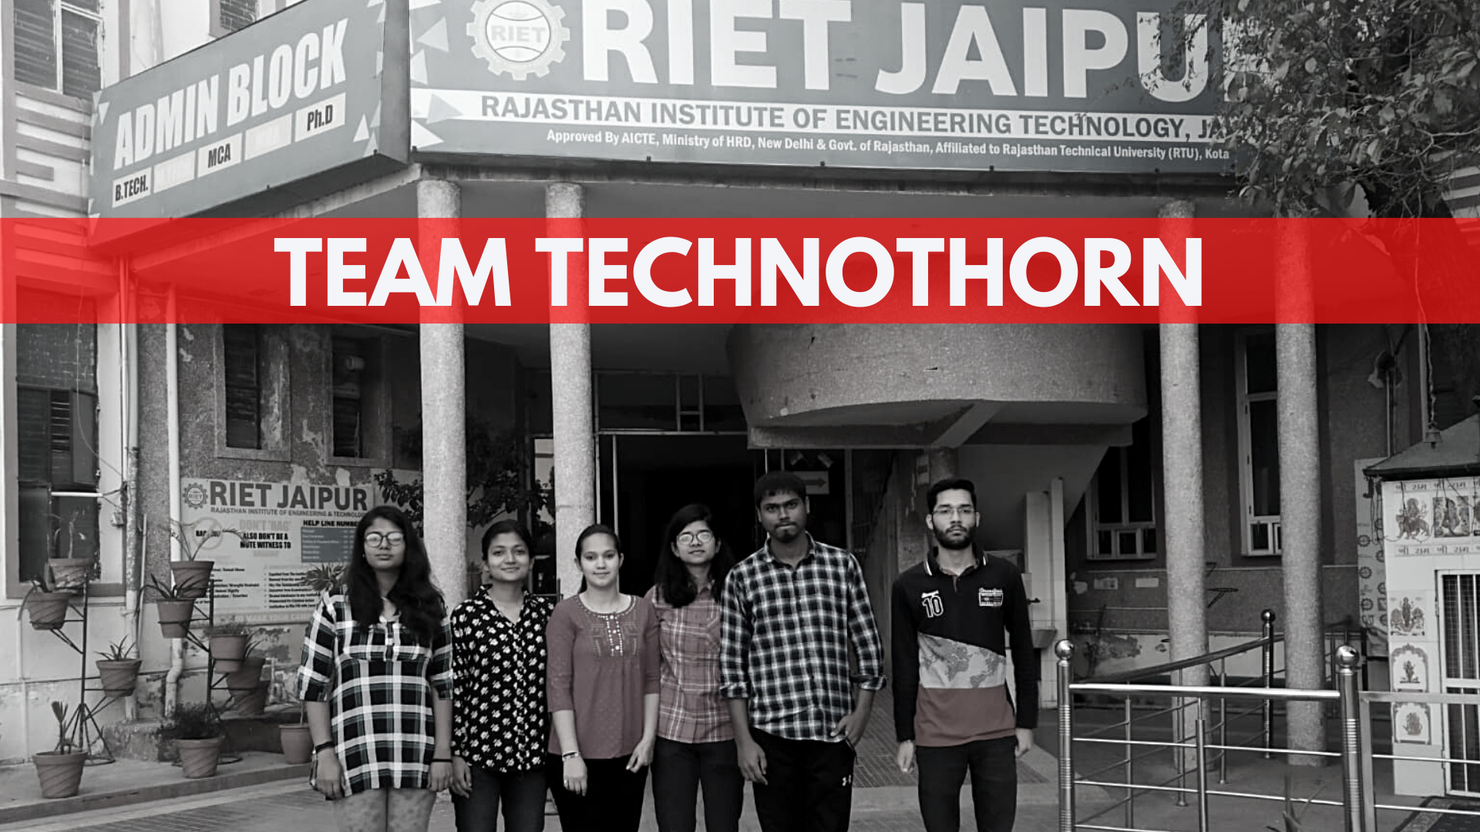
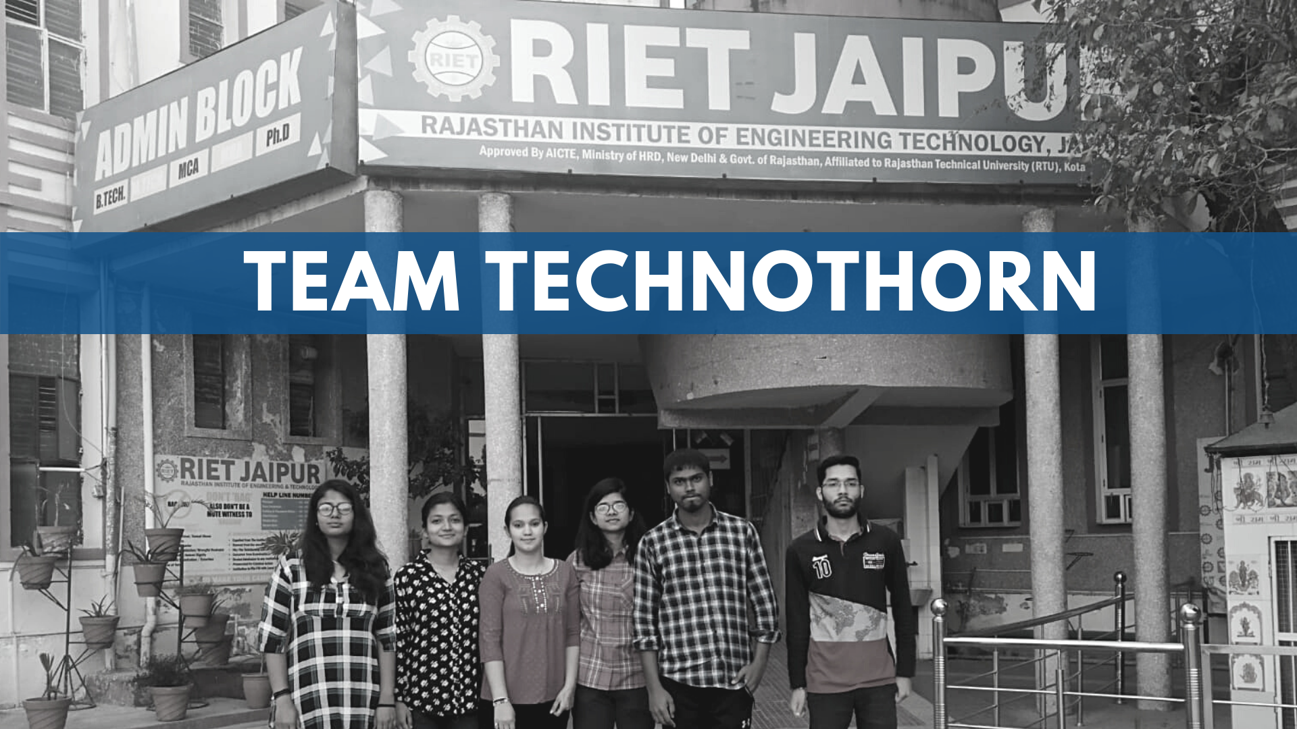
College & Team Info
We the students of Rajasthan Institute of Engineering and Technology, Jaipur visioned for a system which can an ease out the entire concept of traveling in no time.
Our team, Technothorn is the best concoction of innovative thinkers and great illustrators who are competent enough to empower innovation.
We are a team of Data Analysts and Design engineers which is a perfect blend of both the worlds and hence, we are trying to bring thoughts and ideas to reality.

Slide 4
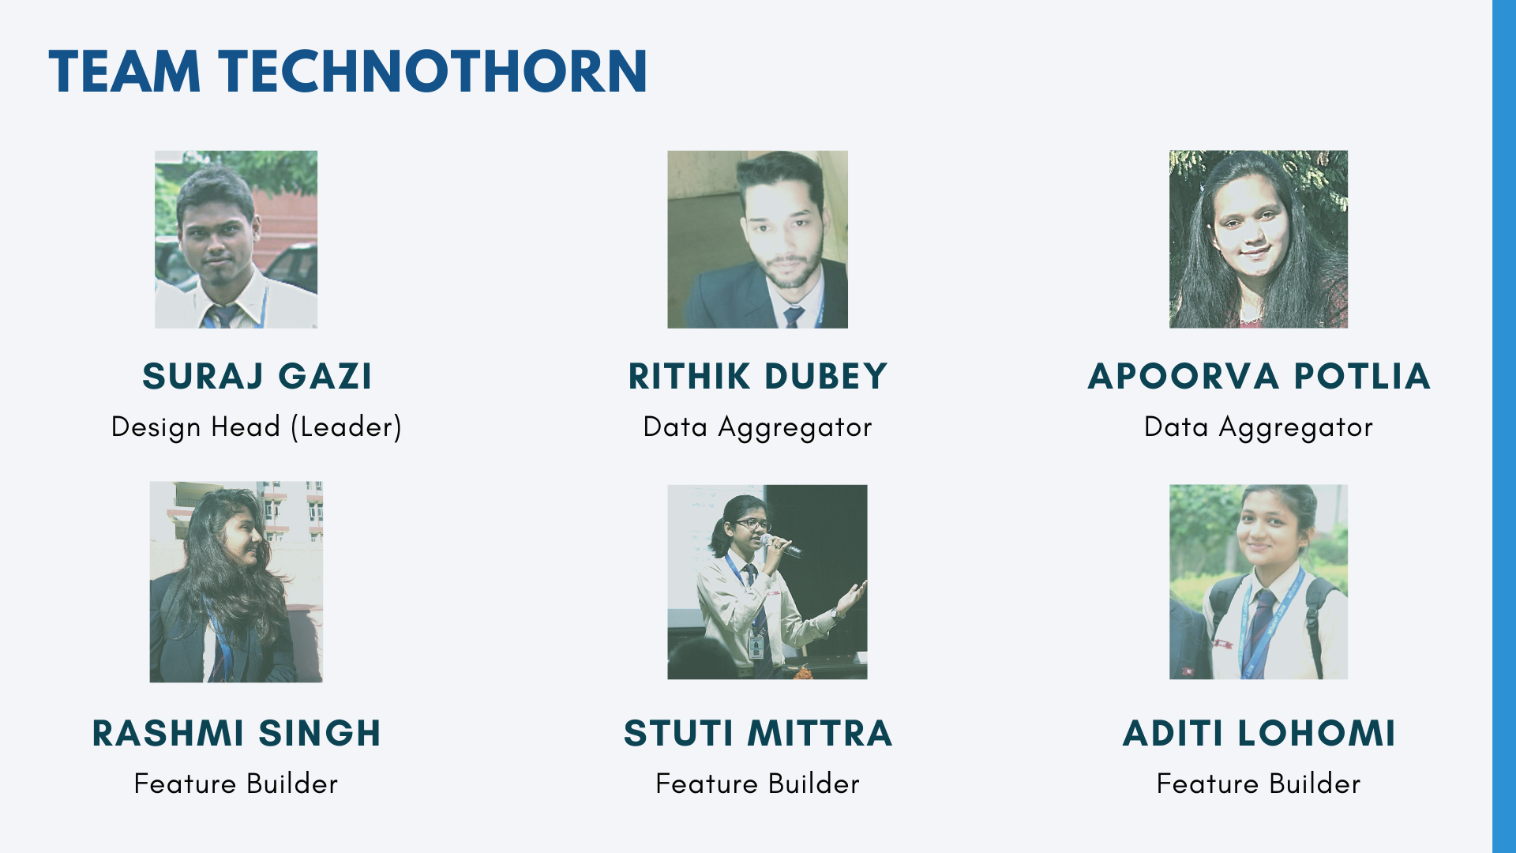
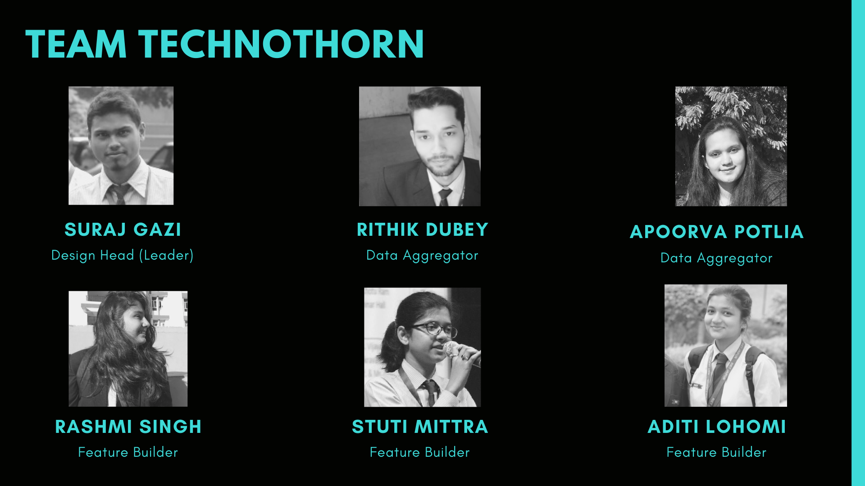

Slide 5
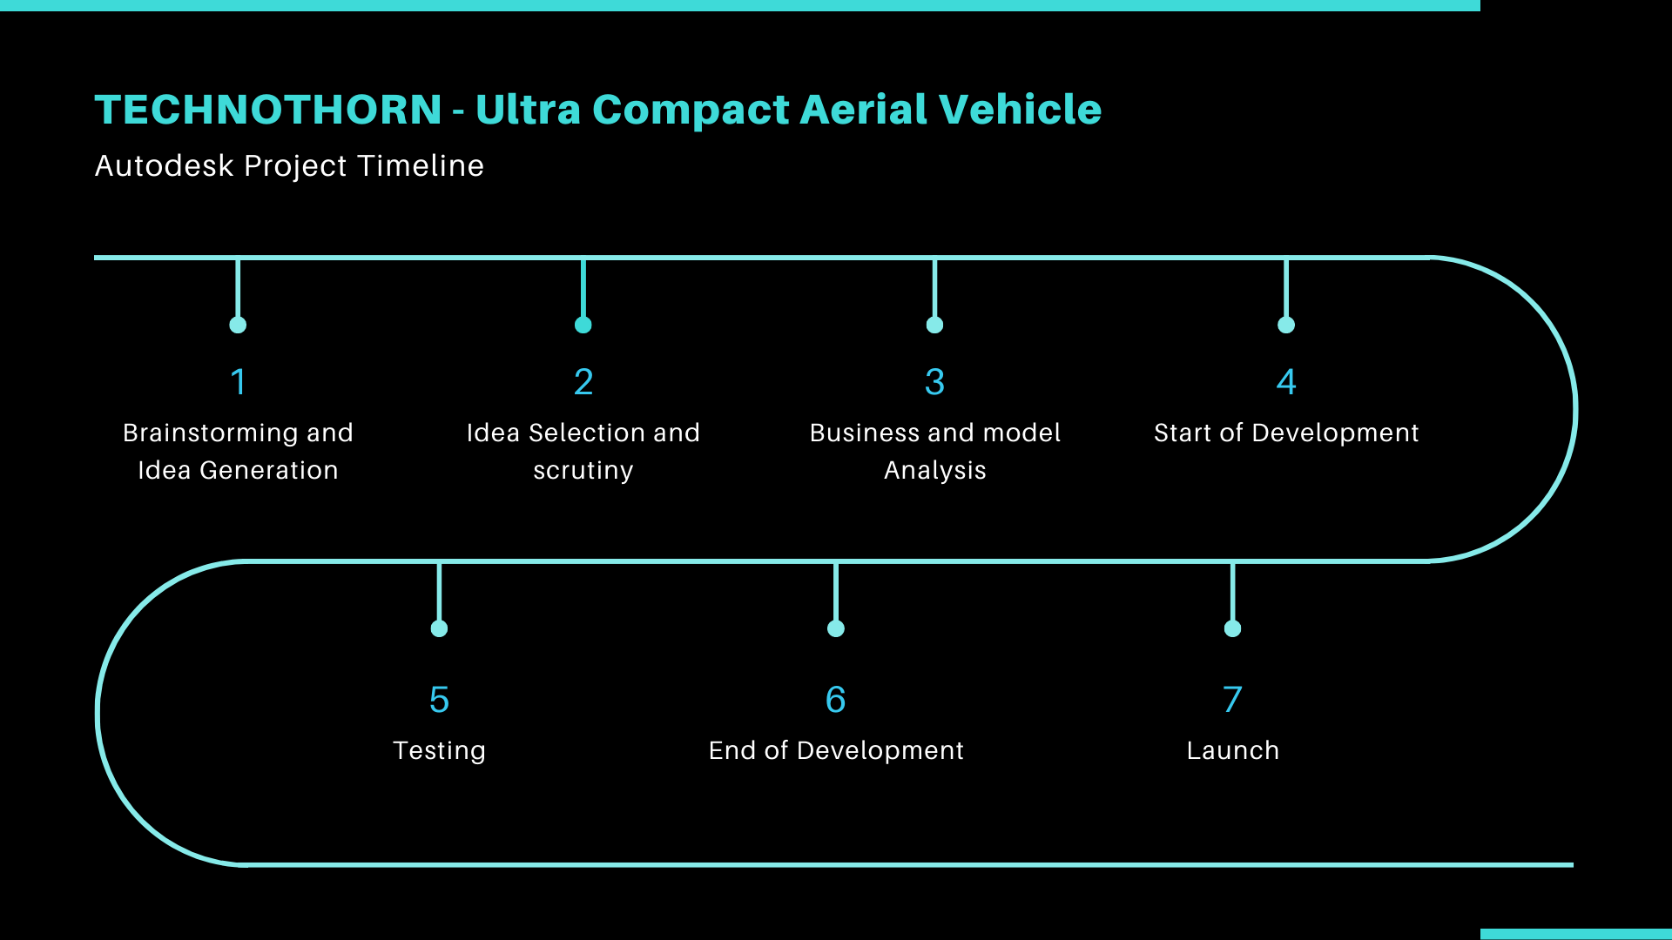
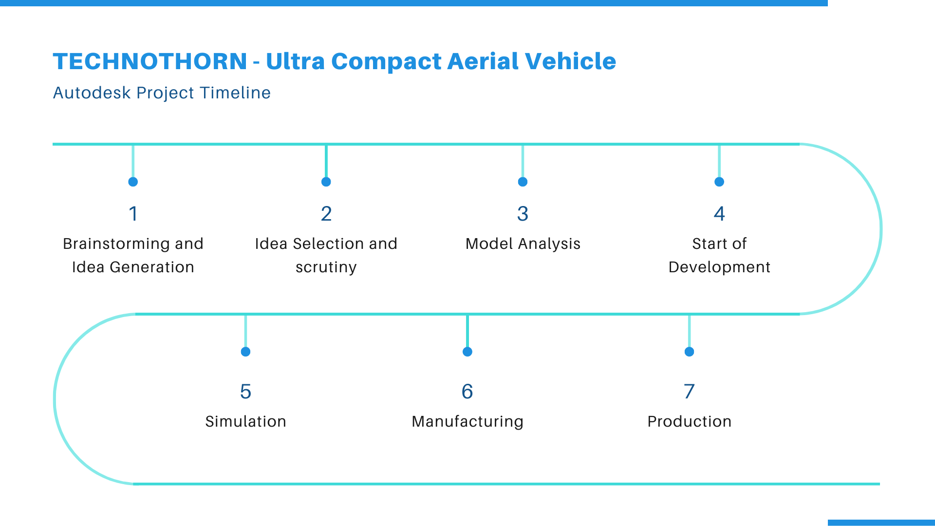

Slide 6

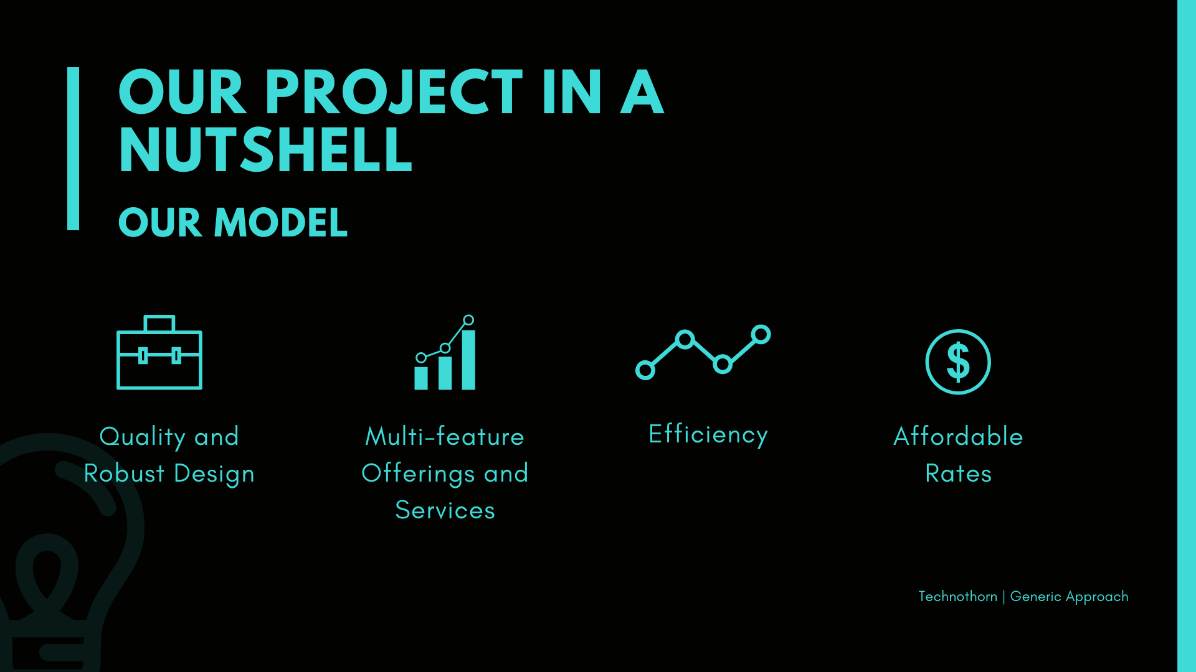
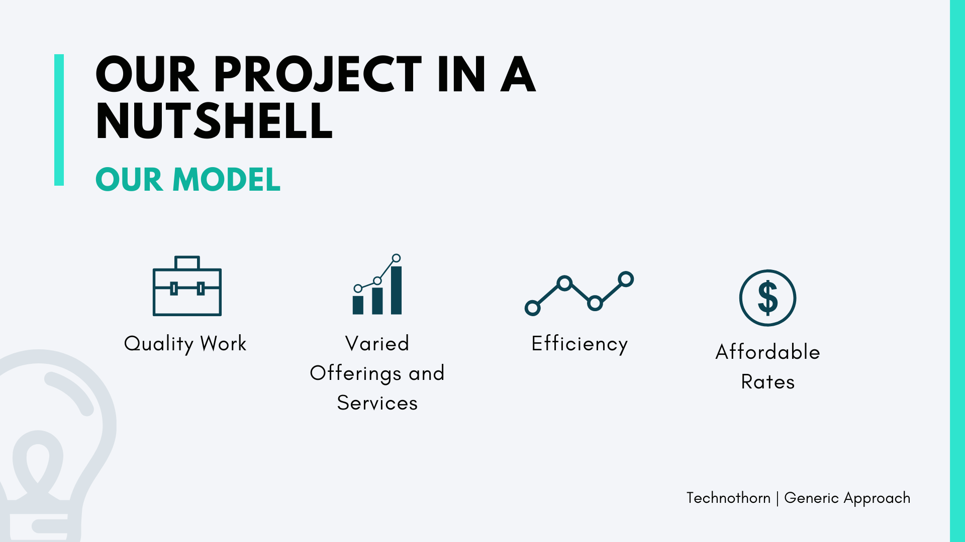
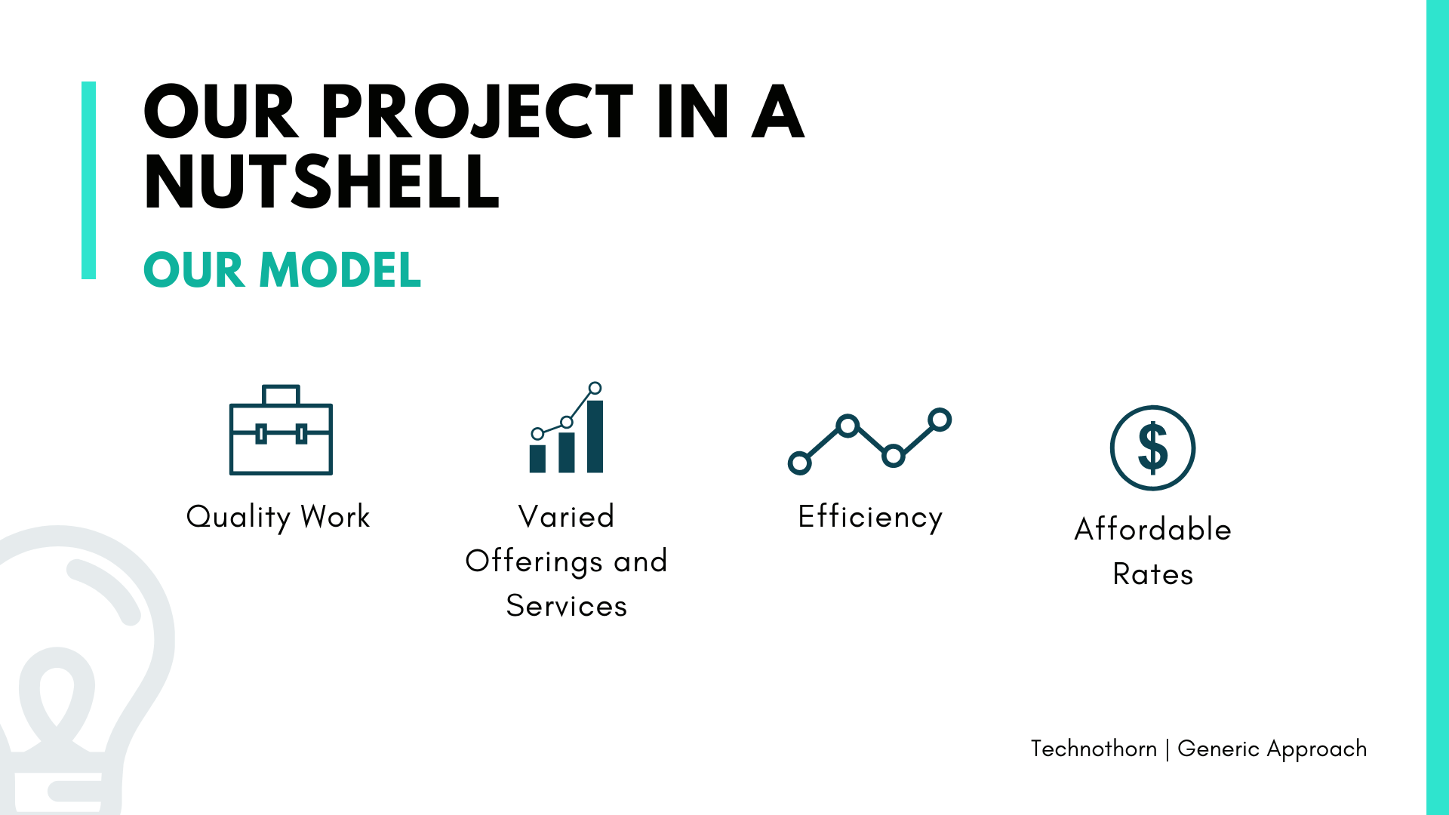

Slide 7
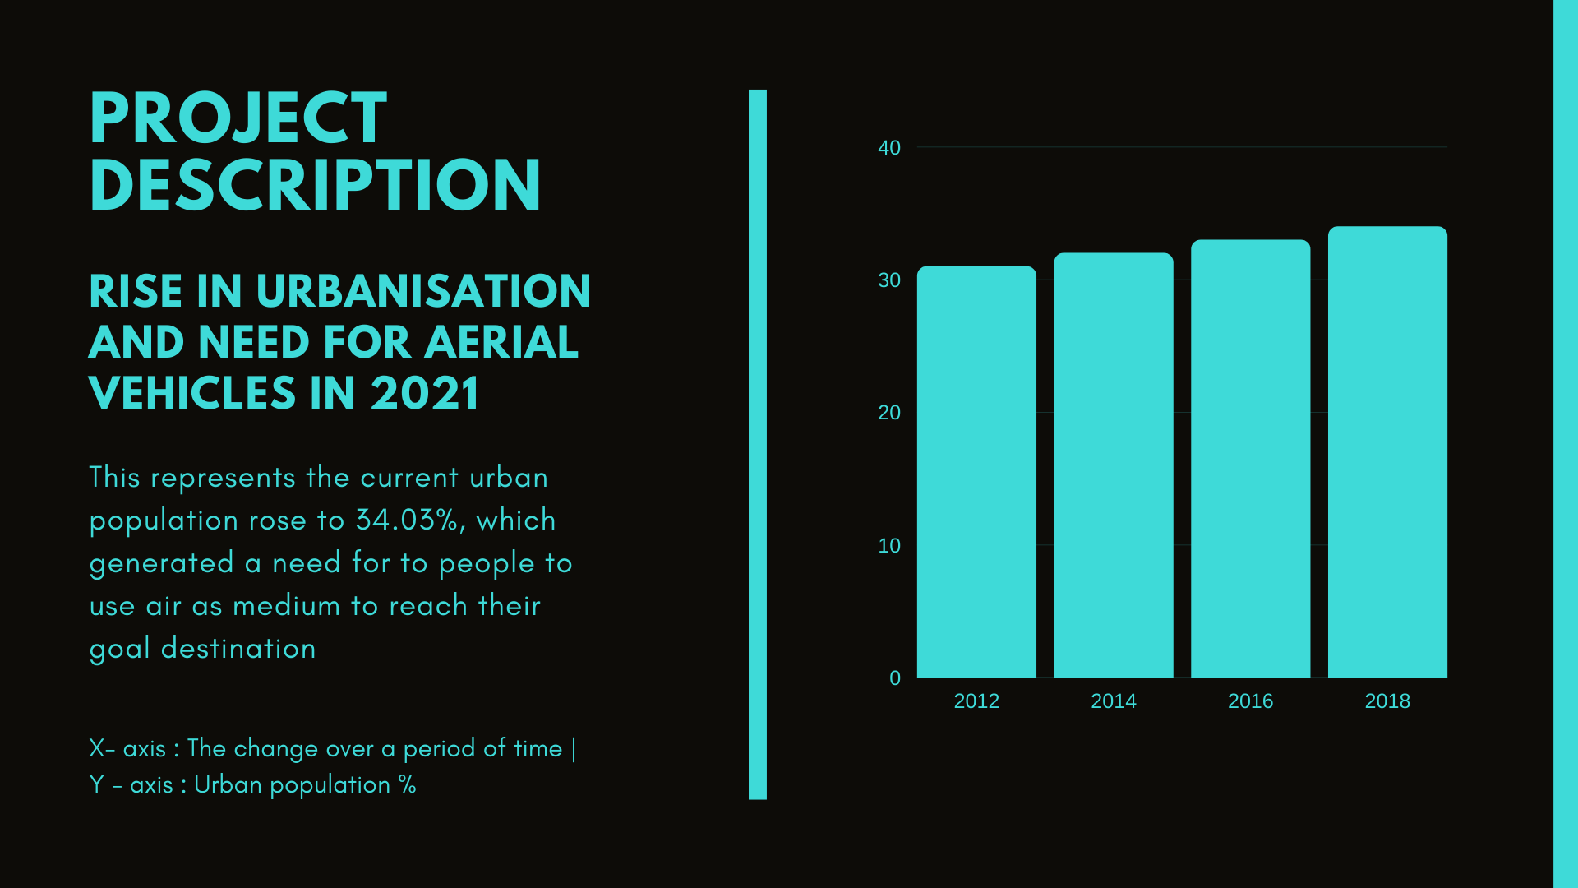
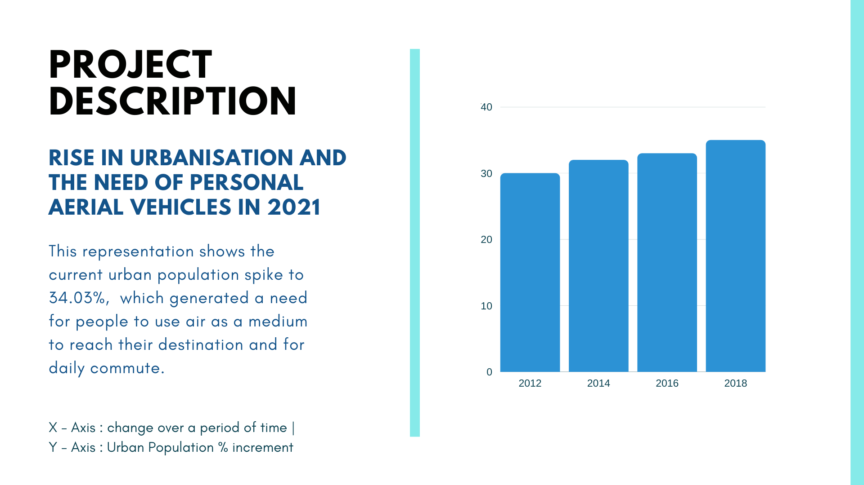

Slide 8


Slide 9
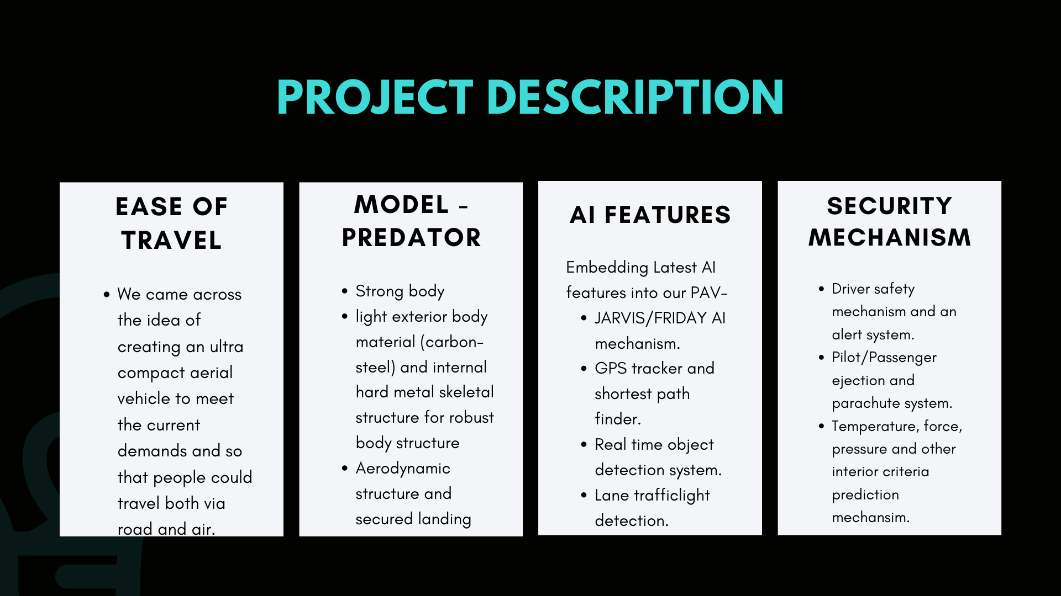
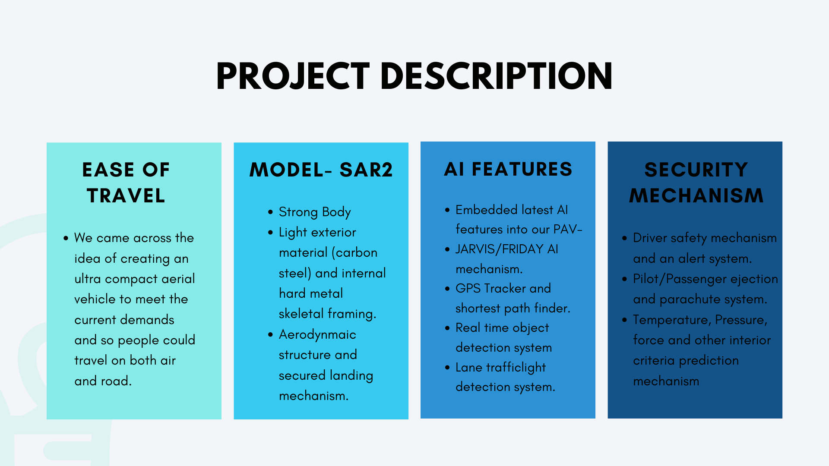


Slide 10
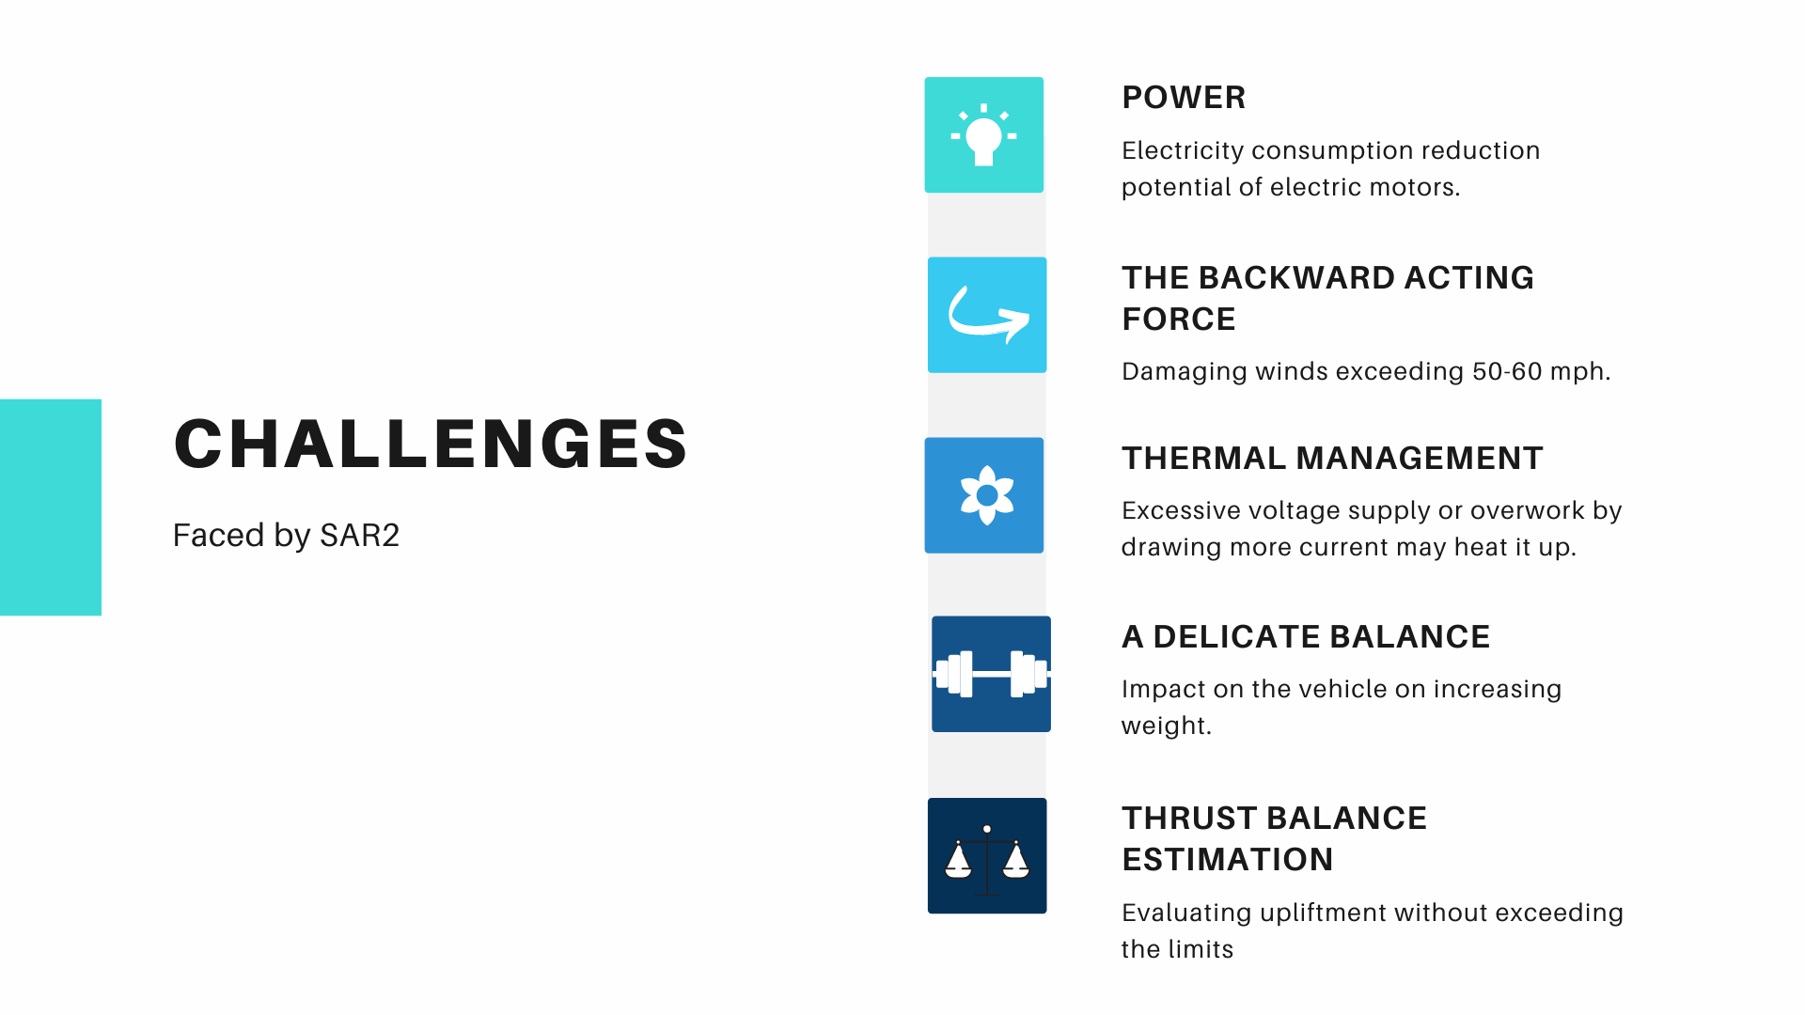

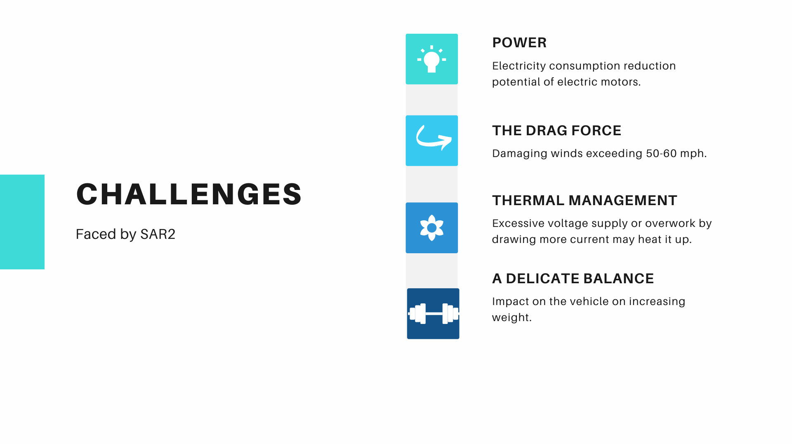

Slide 11
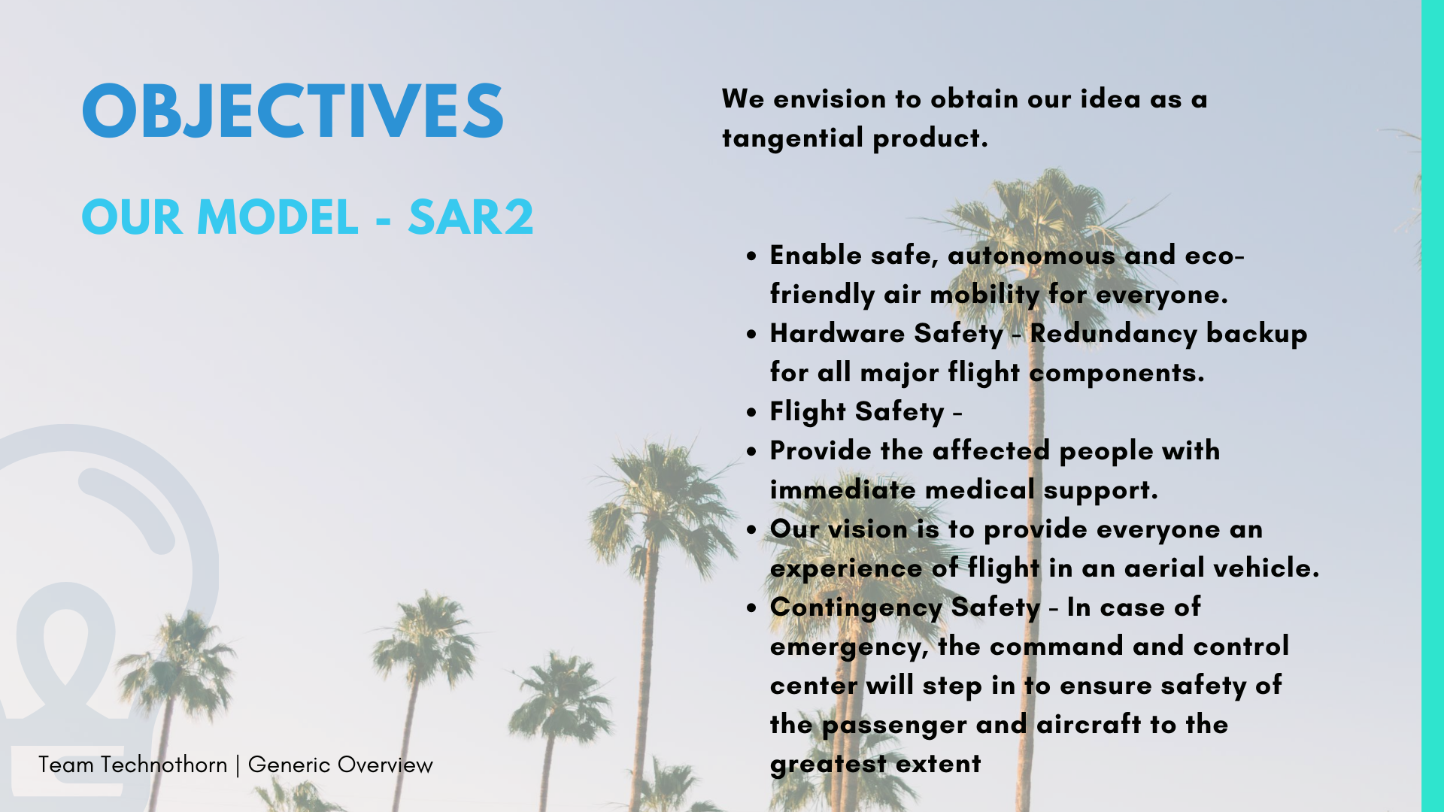
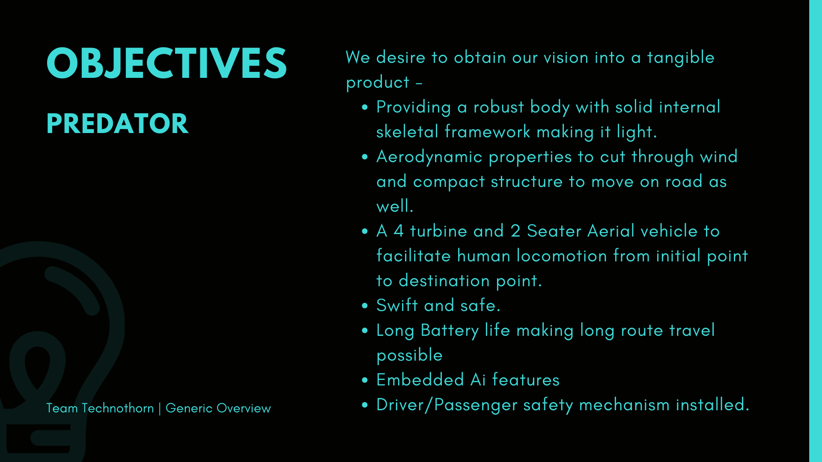
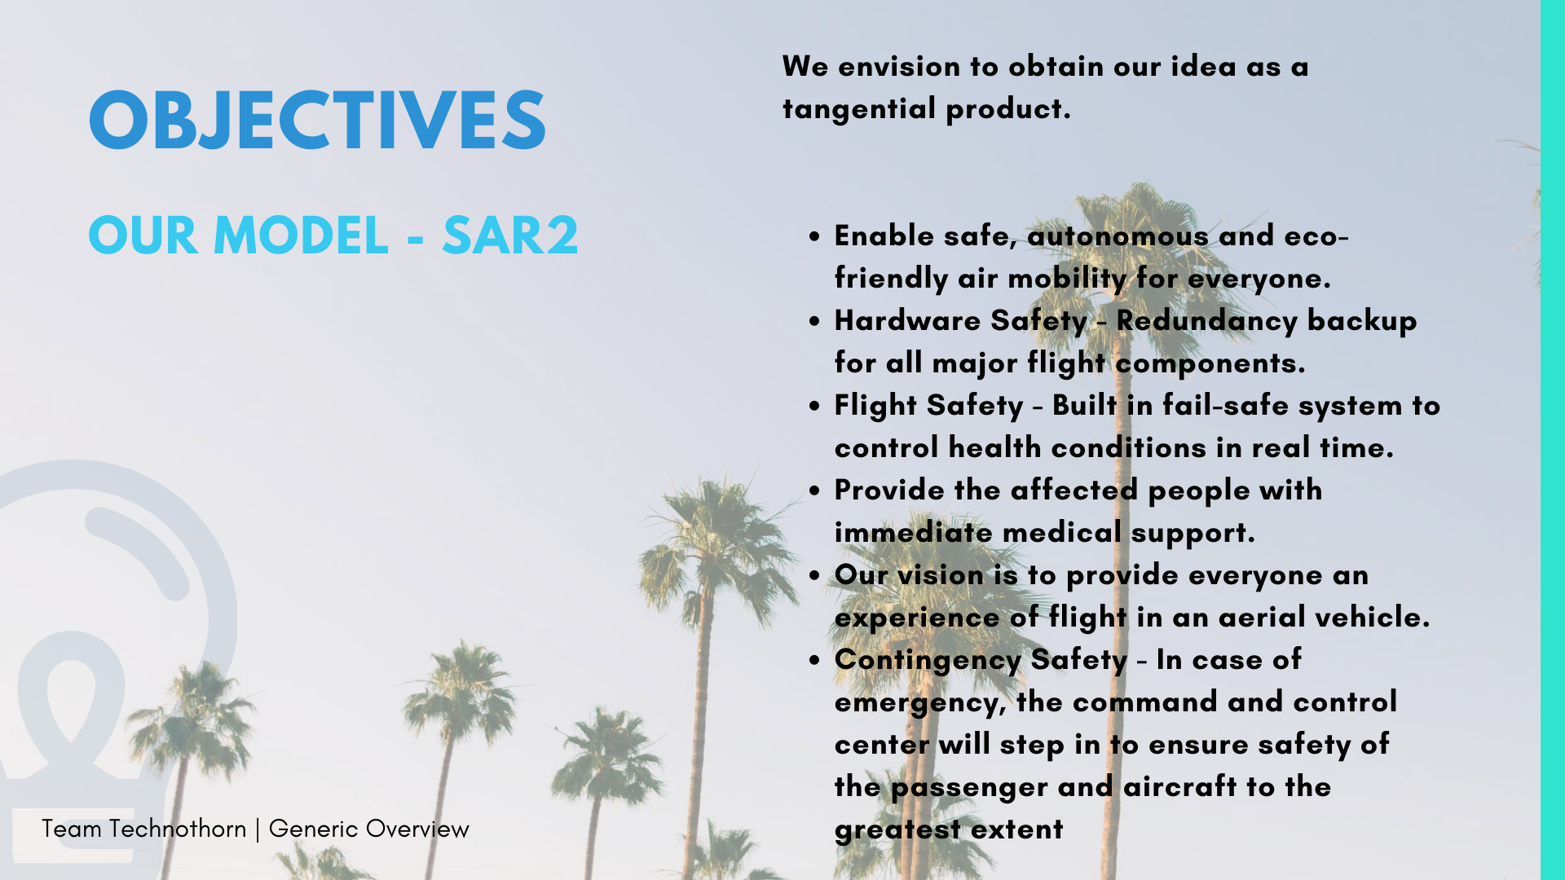


Slide 12
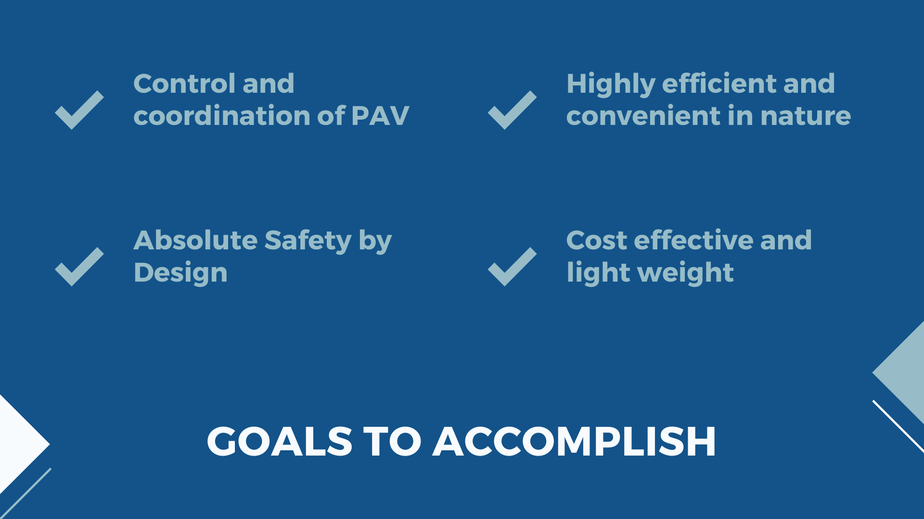

Slide 13
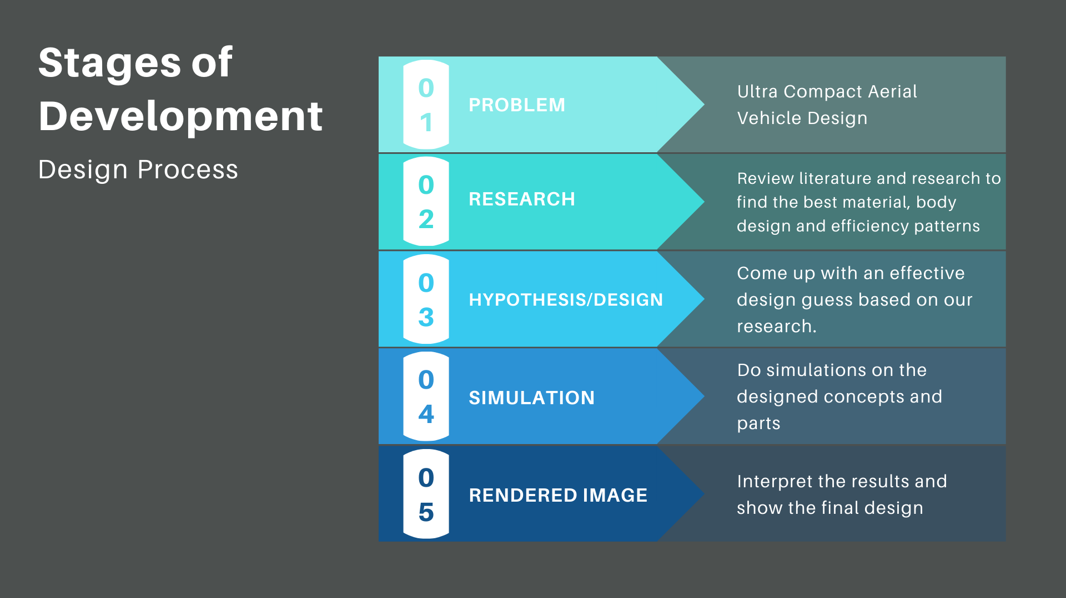
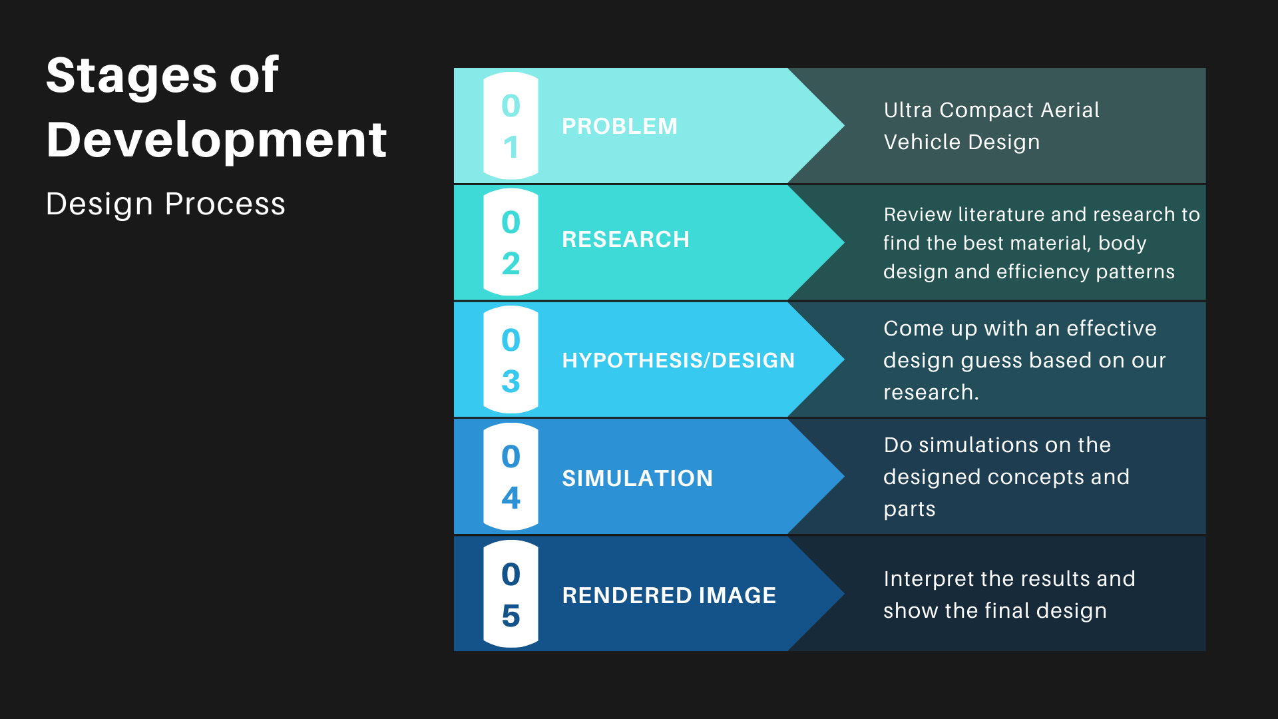
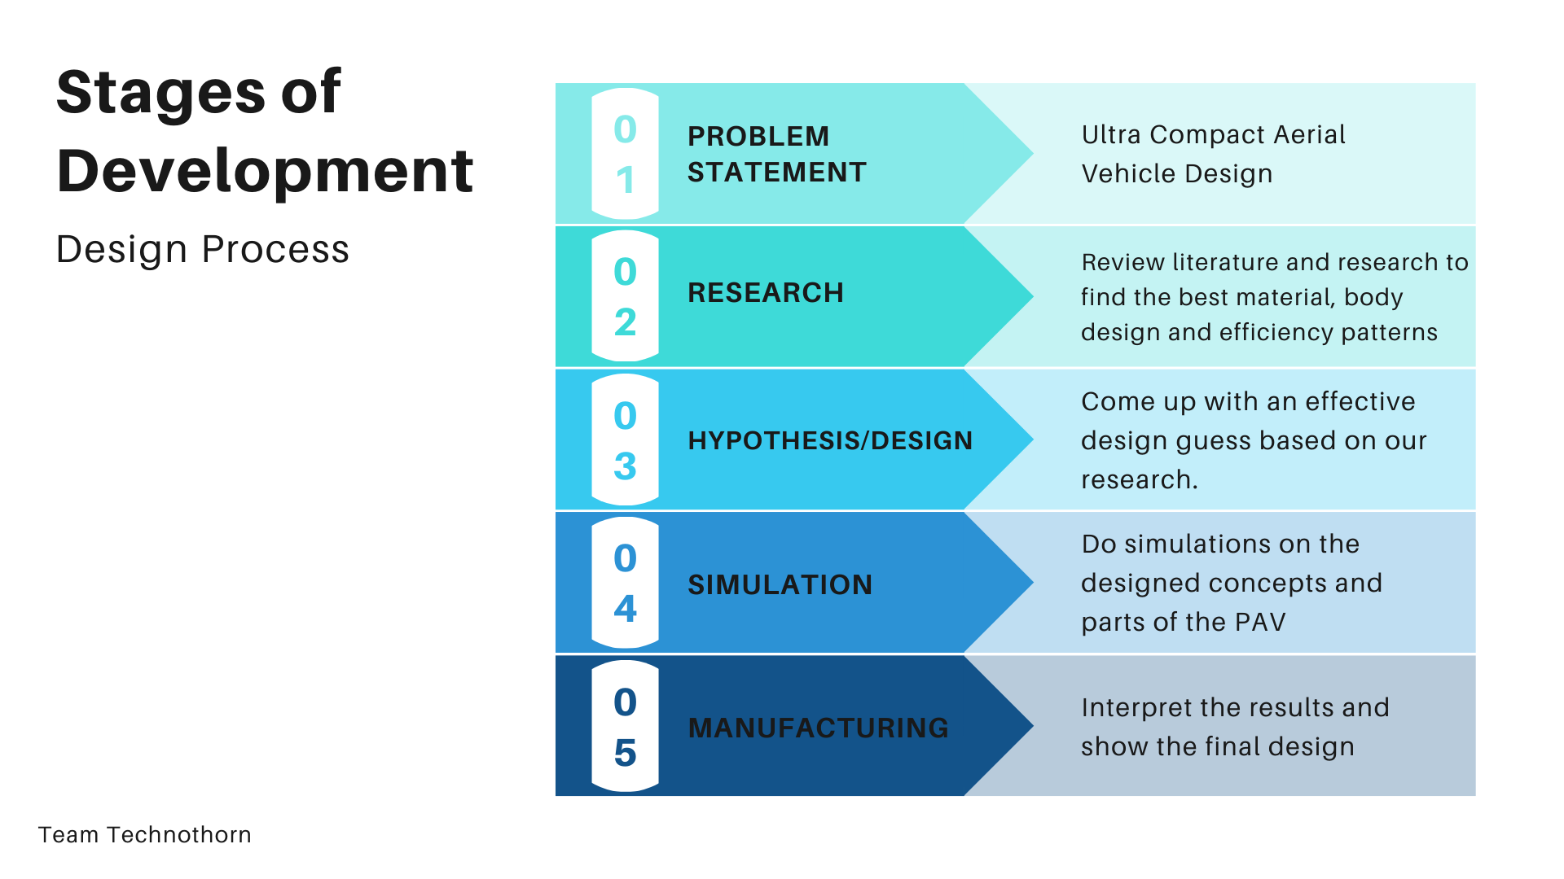
Design Process

Slide 14
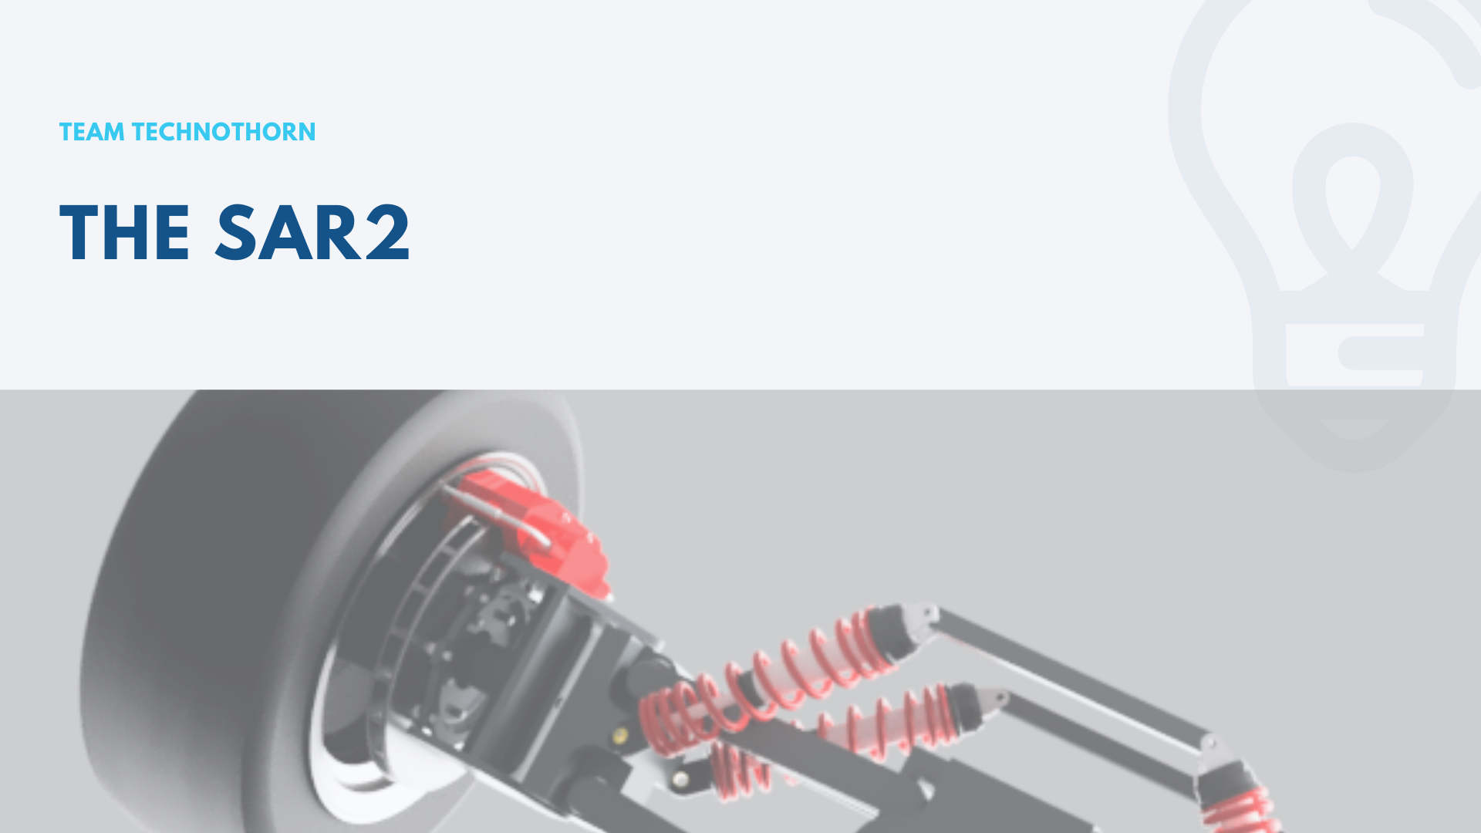
THE PREDATOR

Slide 15
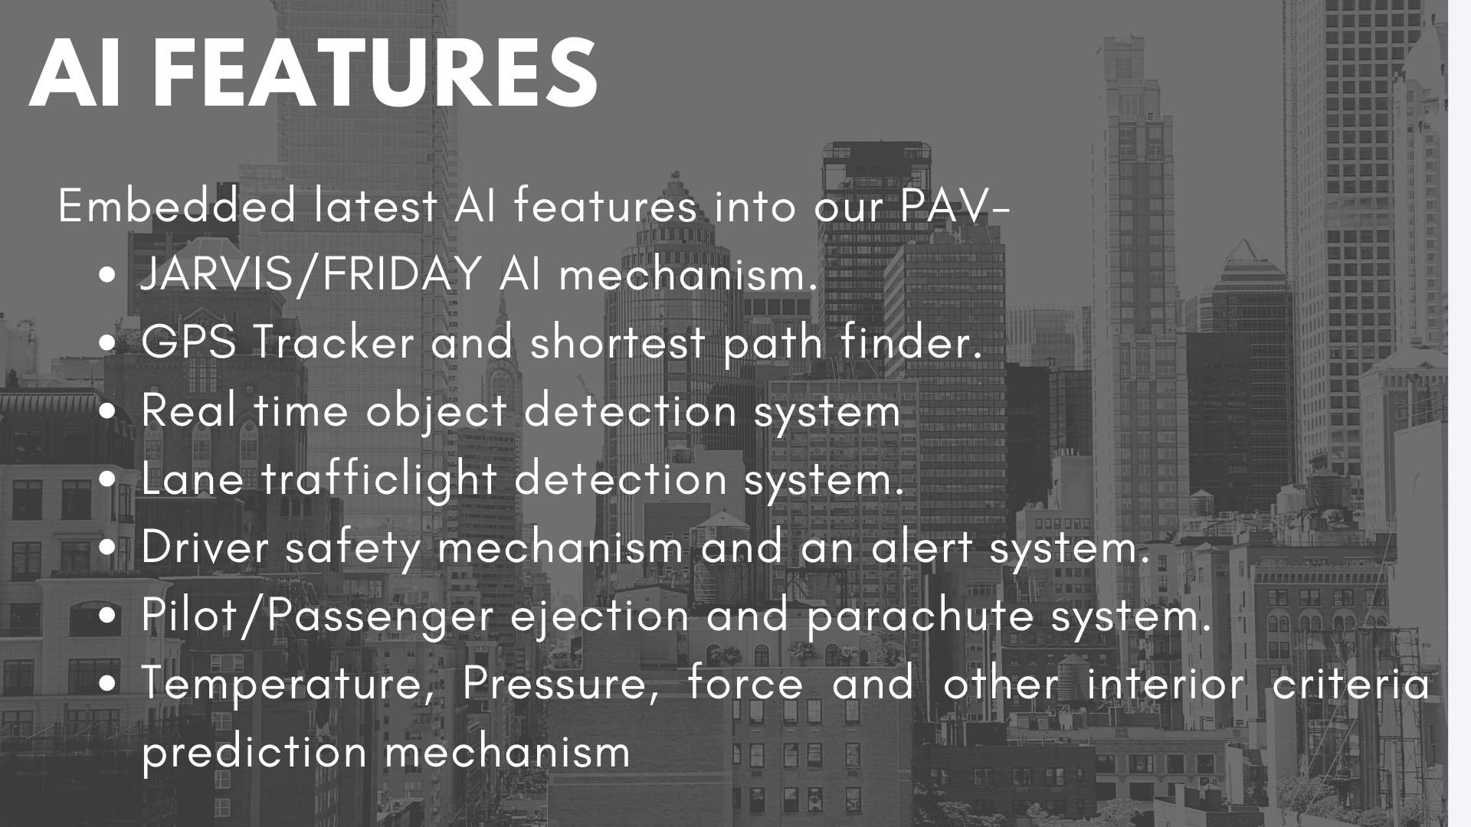

Slide 16

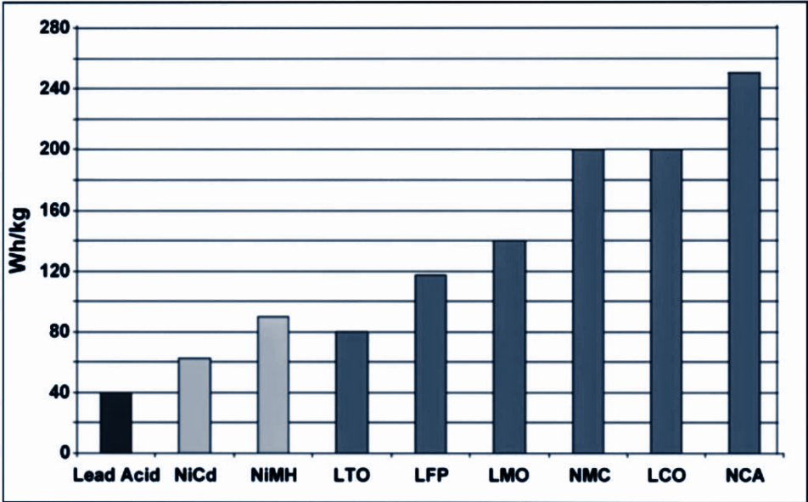
The Li-ion battery
While Li-aluminum (NCA) is the clear
winner by storing more capacity than
other systems, this only applies to
specific energy.
In terms of specific power and thermal
stability, Li-manganese (LMO) and
Li-phosphate (LFP) are superior.
Typical specific energy of lead-, nickel- and lithium- based batteries.

Slide 17
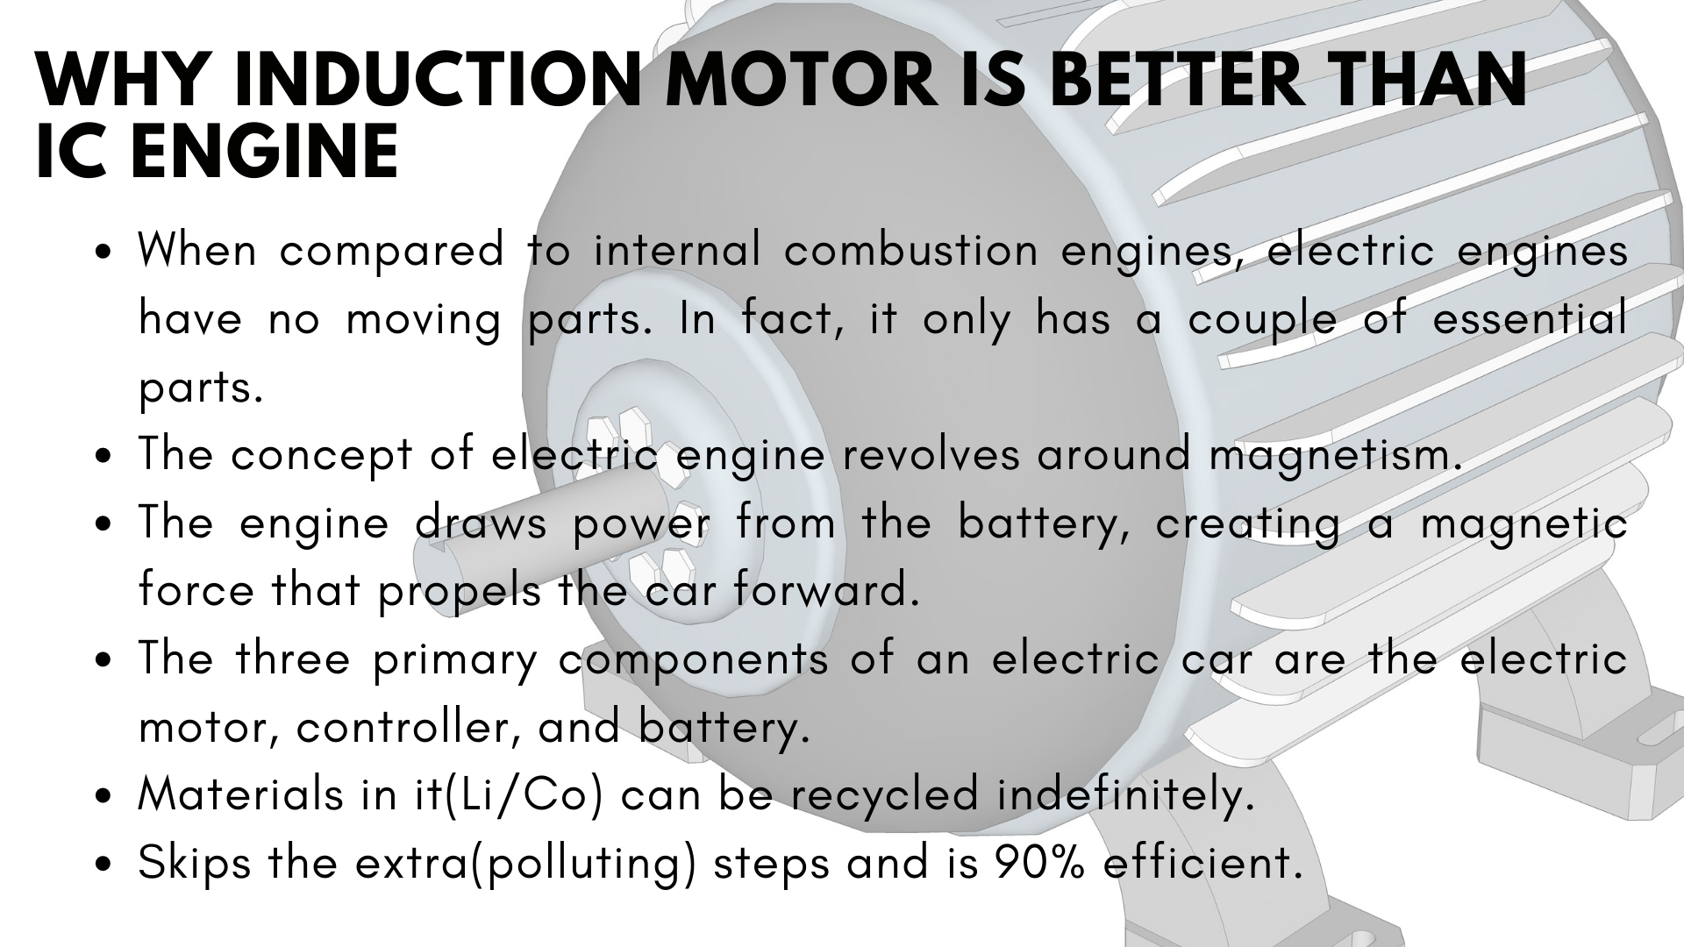
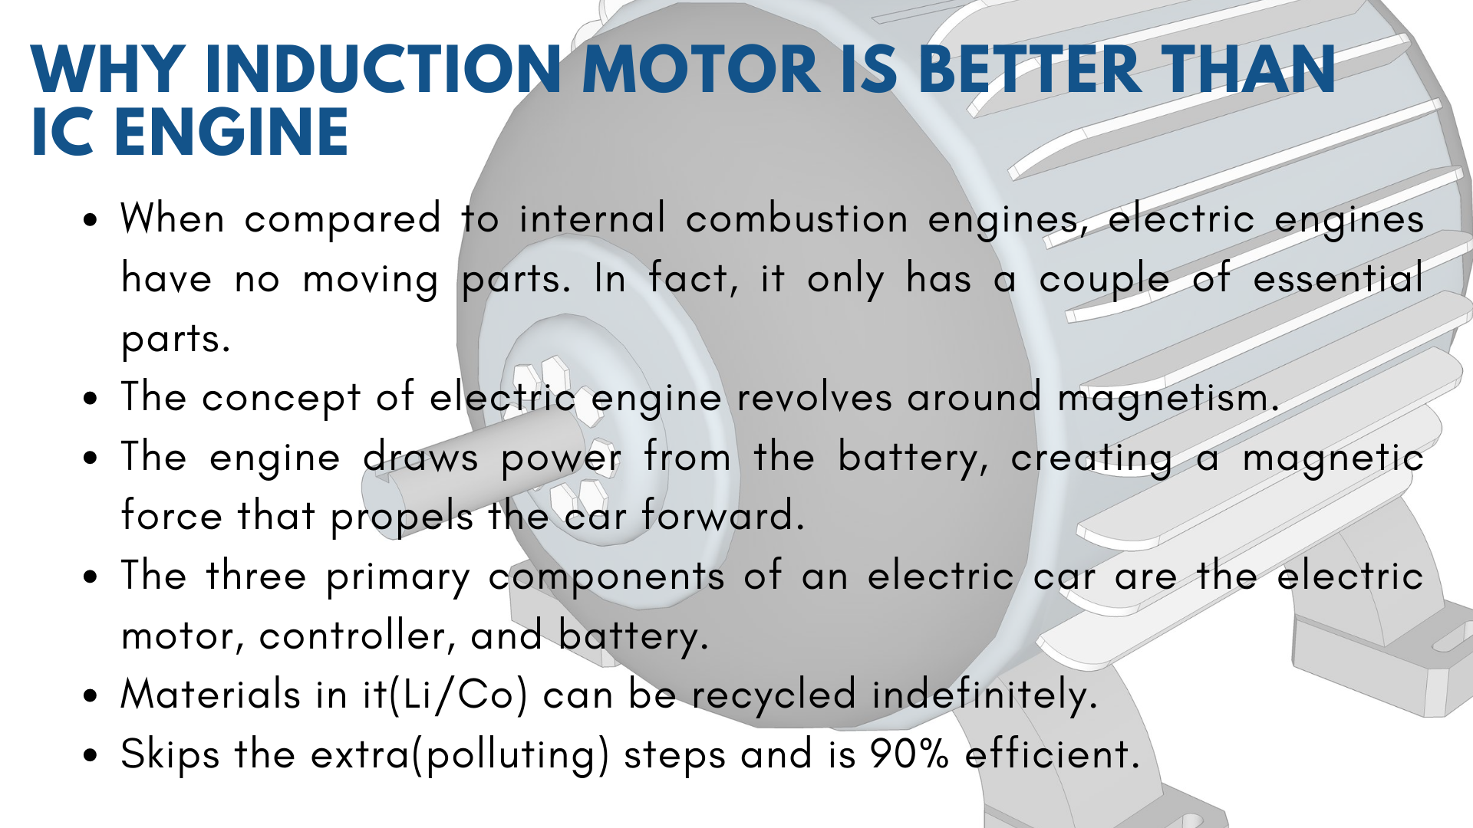

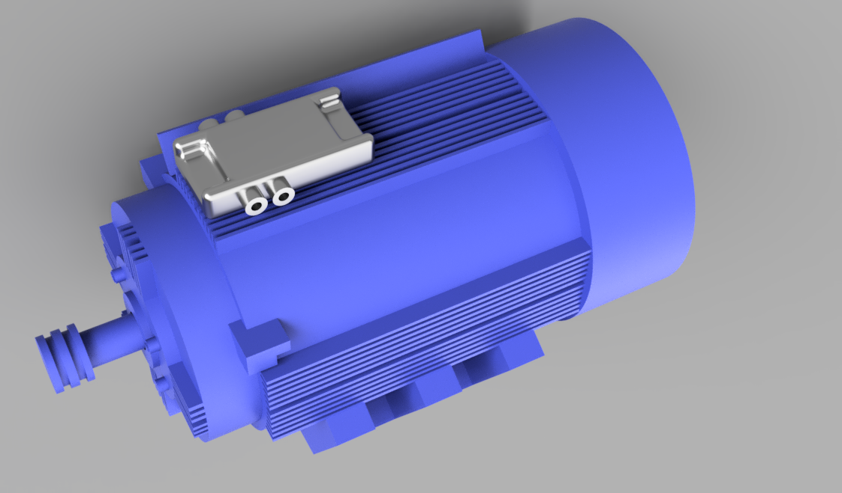
Why Induction motor ?
Rely on Electromagnetism.
90% efficiency.
Skips the extra(polluting) steps.
Materials in it(Li/Co) can be recycled indefinitely.

Slide 18
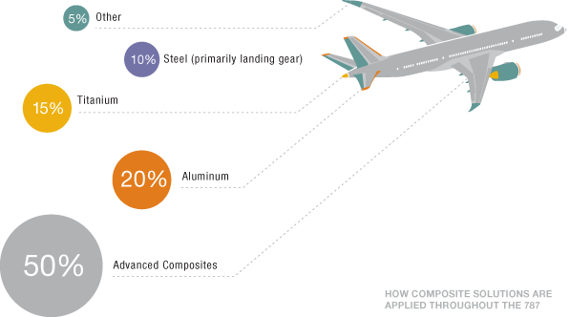

MATERIALS USED IN PAV

Slide 19
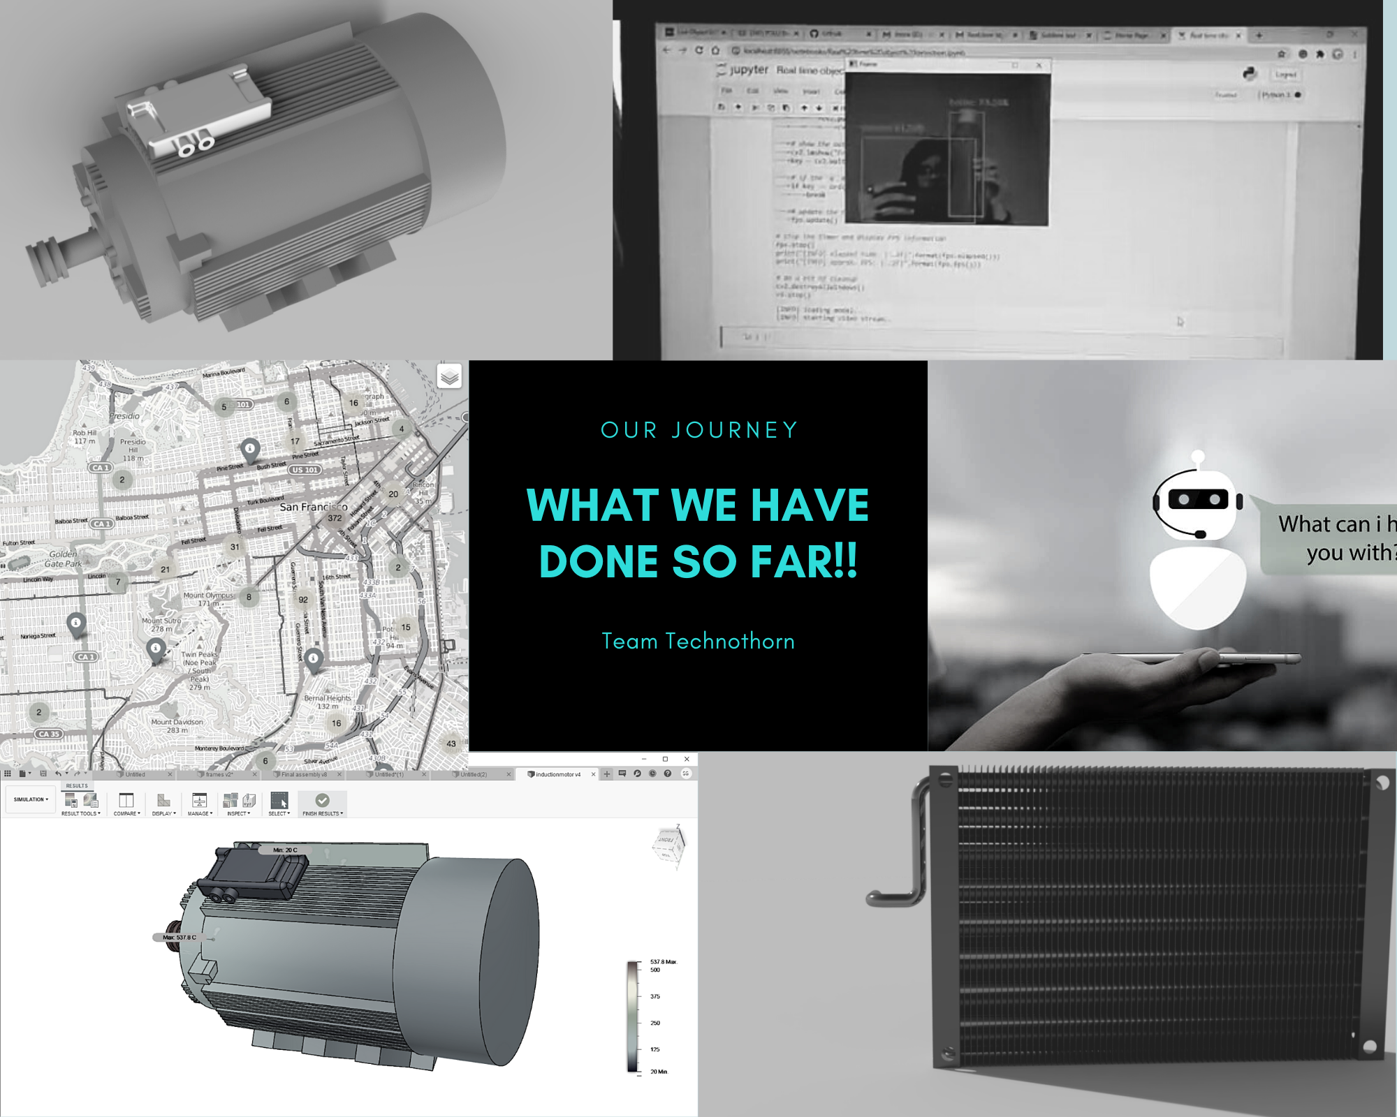

Slide 20


Slide 21
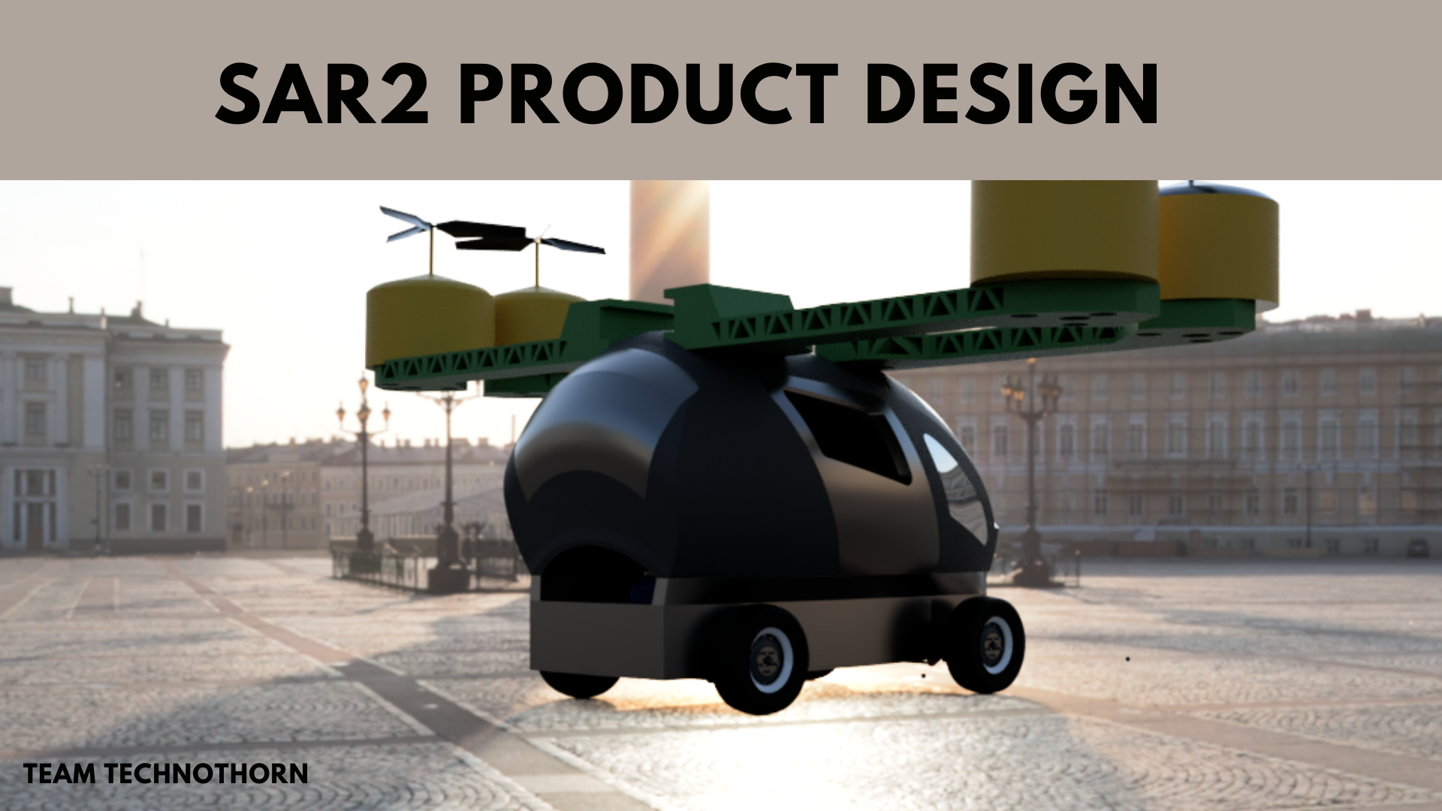
Final Product Image
# with every part description and specification
# a small rendered video if possible to be appended.
# add mission and vision
# add AI features slide.

Slide 22



OPEN FOR SUGGESTIONS

